Slide 1
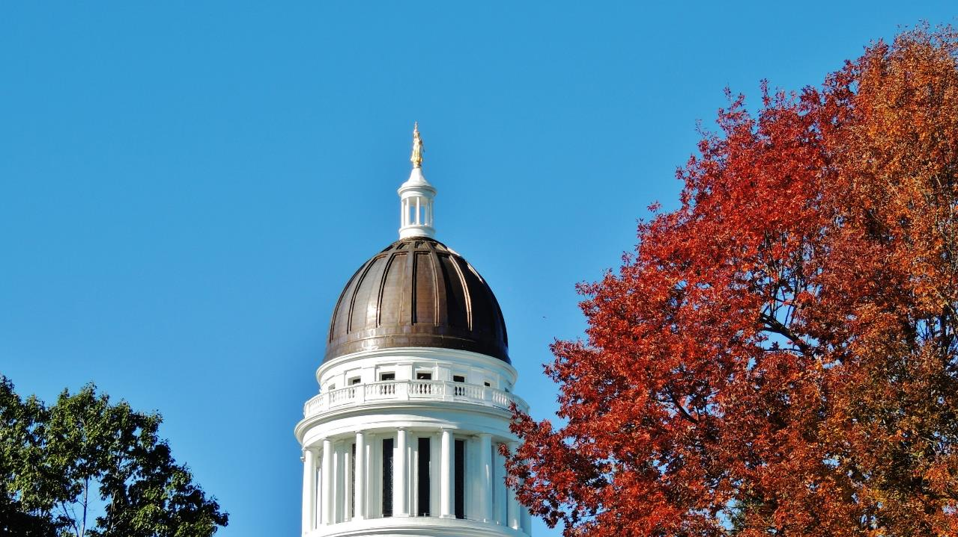
Brian Ambrette
Senior Climate Resilience
Coordinator

Slide 4
Notes:
On December of 2020, the Maine Climate Council delivered Maine Won’t Wait, the state’s 4 year climate action plan, to the Governor and the Legislature. The plan lays out strategies to meet Maine’s emissions and resilience targets.
I am going to share with you how we are supporting towns and communities to take local climate action that aligned with the state’s goals and strategies, so I will start briefly with a summary of the state’s plan.

Slide 5
Maine’s 8 Climate Action Strategies
A. Embrace the Future of Transportation in Maine
D. Grow Maine’s Clean Energy Economy and Good Jobs
G. Invest in Climate-Ready Infrastructure
E. Protect Maine’s Environment and Working Lands and Waters, Increase Carbon Sequestration
H. Engage People and Communities in Climate Impacts and Program Opportunities
B. Modernize Maine's Buildings
C. Reduce Carbon Emissions the Energy and Industrial Sectors through Clean Energy Innovation
F. Build Healthy and Resilient
Communities

Slide 7
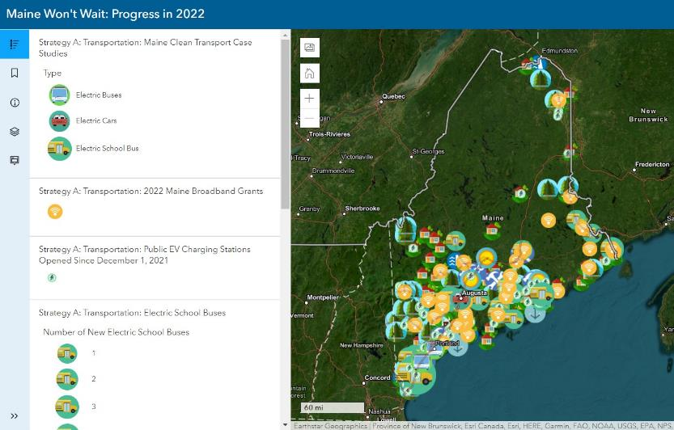
maine.gov/climateplan/dashboard

Slide 8
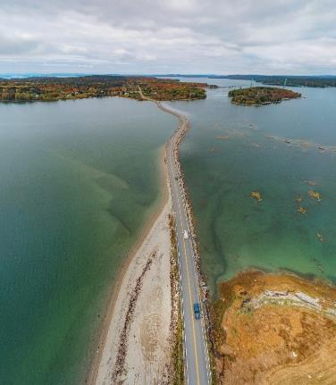
Strategy F:
Build Healthy and Resilient Communities
Empower Local and Regional Community Resilience Efforts
Emphasize Resilience Through Land-Use Planning Tools
Strengthen Public-Health Monitoring, Education, and Prevention

Slide 9
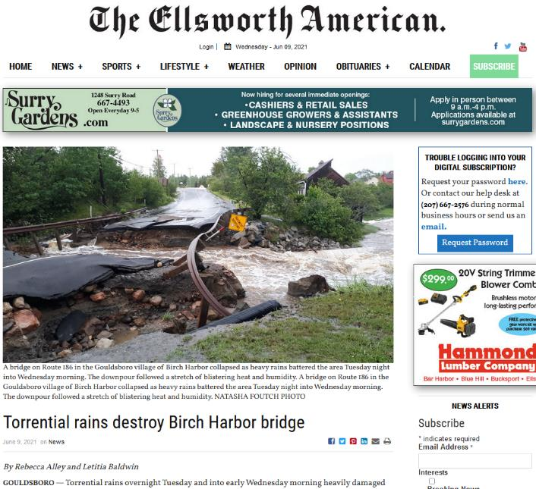

Slide 10
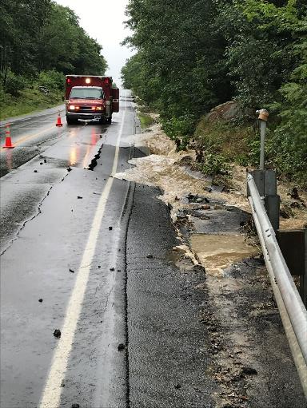
Strategy G:
Invest in Climate-Ready Infrastructure

Slide 11
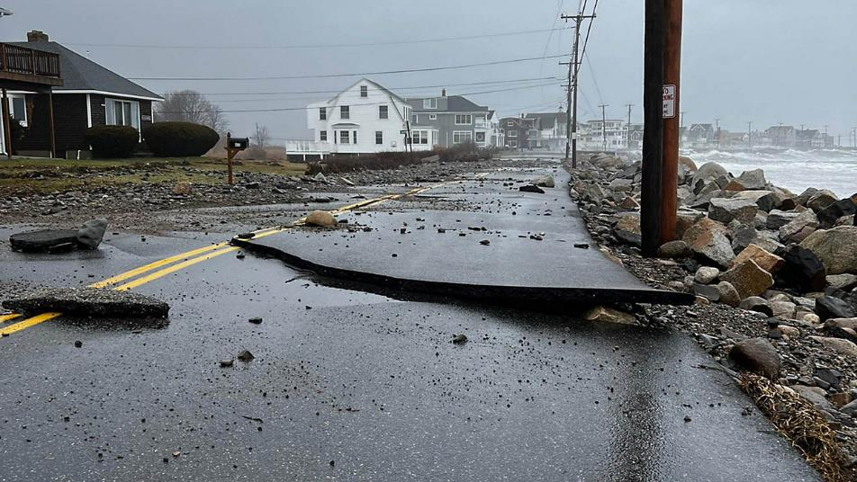

Slide 12
Community Resilience Partnership
$3 million in the biennial budget for local, tribal, and regional grants and assistance to reduce carbon emissions, transition to clean energy, and prepare for climate change impacts. (additional $3M proposed)
Types of funding opportunities
Grants to communities for planning and implementation
Grants to service provider organizations to help communities get started
www.maine.gov/future/climate/community-resilience-partnership

Slide 13
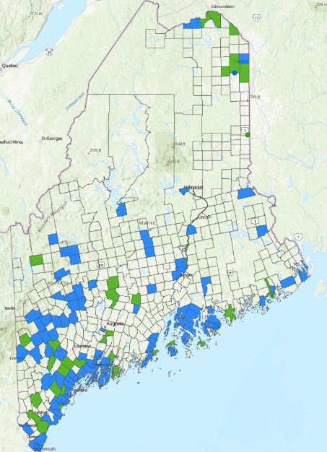
143 participating
communities
Today
109 fully enrolled communities
34 communities working with Service Providers to enroll
In 2022:
74 grants to communities totaling $3.7M
82 communities aided by Service Providers

Slide 14
Fall 2022 Projects
Solar: Aroostook Band of Micmacs, Limestone, Falmouth, Lamoine, Paris, Waterford
Heat pumps: Carthage, Cumberland, Falmouth, Farmington, Greenwood, Lamoine, Livermore, Millinocket, North Yarmouth, Otisfield
Energy Audits, Facility Efficiency Projects: Bar Harbor, Bath, Bethel, Bowdoinham, Castine, Georgetown, Harpswell, Jay, Woodstock
Electric vehicles, EV charging, Complete Streets: Camden, Hallowell, Carrabassett Valley, Dover-Foxcroft
Climate Action Plans: Brunswick, Freeport & Yarmouth, Mount Desert, North Yarmouth, Orono & Bangor, Rockport, Tremont
Natural systems, nature-based solutions: Lisbon, Lubec
Drinking Water Supply & Infrastructure: Chebeague Island, Westport Island, Monhegan Plantation
Vulnerable Infrastructure: Blue Hill & Brooksville, Fort Kent, Islesboro, St. George, Rockland, Surry
Outreach, vulnerable populations, youth: Arrowsic, Portland, Kennebunkport & Kennebunk, South Portland, Eastport & Passamaquoddy Tribe at Pleasant Point, Woolwich

Slide 15
Spring 2023 round of grants is now open
Service Provider Grants
Deadline June 23
Info webinar June 1, 1:00pm
Community Action Grants
Deadline July 7
Info webinar June 1, 3:00pm
Links to the Applications and Webinars are on the CRP website:
https://www.maine.gov/future/climate/community-resilience-partnership

Slide 16
Contacts
Brian Ambrette
Senior Climate Resilience Coordinator
Brian.Ambrette@maine.gov
Ashley Krulik
Community Resilience Partnership Program Manager
Ashley.Krulik@maine.gov
Governor’s Office of Policy Innovation and the Future
www.maine.gov/future/climate/community-resilience-partnership

