Slide 1

EMDC
12th Annual
Grants
Conference
May 23, 2023

Slide 2

CDBG Funding is provided by HUD through an annual allocation to the State CDBG Program.
Notes:
The State allocation is formula based on population, housing conditions, unemployment, etc., as is the allocation received by Maine’s entitlement communities and Cumberland County.
Auburn ME $539,980 Bangor ME $836,831 Biddeford ME $380,590 Lewiston ME $840,100 Portland ME $1,845,970
Cumberland County ME $1,548,355
Maine Nonentitlement ME $11,862,076

Slide 3
Current Schedule
Program | Letter of Intent Due Date | Application Due Date
 | VIA E-MAIL | By Invitation Only
Downtown Revitalization | January 27, 2023 | March 10, 2023
Economic Development | 1st of the month starting July 1,2023 | Per invitation
Housing Assistance | March 24, 2023 | May 19, 2023
Public Infrastructure | NA | NA
Public Service | March 24, 2023 | May 5, 2023
Community Enterprise | February 24, 2023 | April 14, 2023
Special Projects | TBD | TBD
Urgent Need* | TBD | TBD

Slide 4

2023 CDBG Budget $11,862,076
Administration $337,241
Technical Assistance Administration $118,620
This Photo by Unknown Author is licensed under CC BY-NC-ND

Slide 5

Community Development
Rural Housing Preservation Program 1,000,000
Downtown Revitalization Grants 300,000
Home Repair Network Program 1,000,000
Housing Assistance Grants 2,000,000
Public Service Grants 200,000
Public Infrastructure Grants 2,800,000
Regional Council Planning Assistance 150,000
Small Business Development Centers 100,000
Maine Development Foundation/Downtown Center Assistance 300,000
Community Enterprise Grants 600,000
Special Projects 656,215
Urgent Need Grants* 0

Slide 6

Economic Development Grants 1,000,000
Micro-Enterprise Assistance Grants 1,300,000

Slide 7
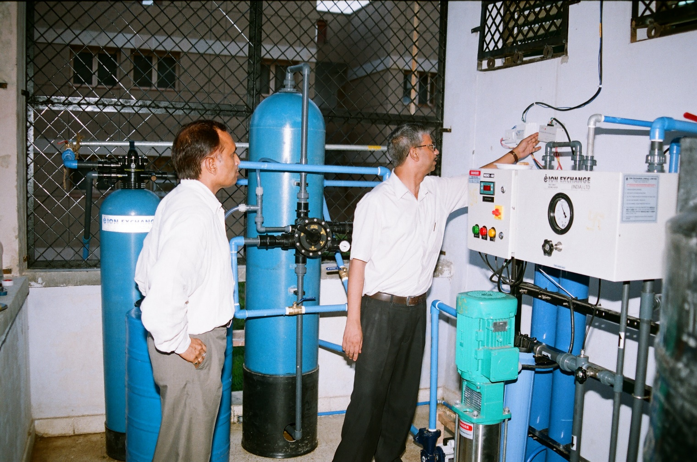
Proposed Budget
Typically, we have about $3 million for sewer and water projects each year. We only take applications on
Even years, the next is 2024.
This Photo by Unknown Author is licensed under CC BY-SA

Slide 8
Funding for the 2024 Program year will not be available until after:
August 1, 2024
Notes:
Again….a reminder.

Slide 9
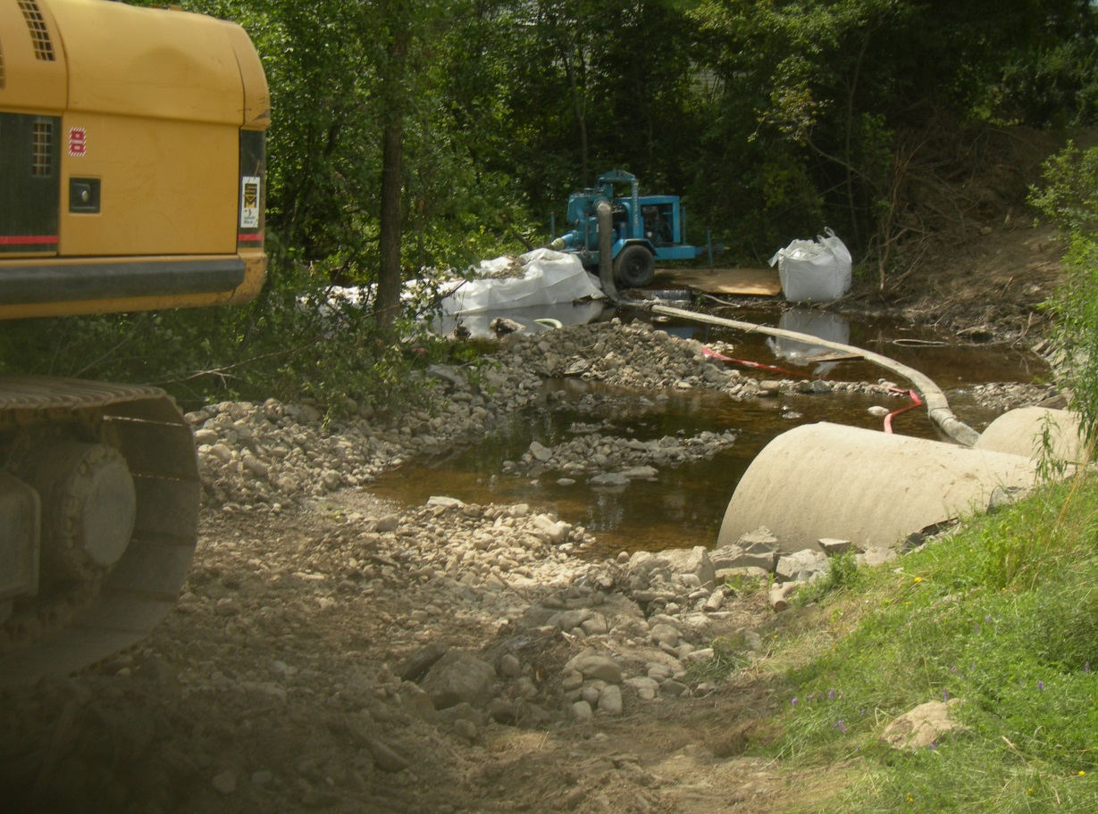
Funding:
The community may need to obtain funding to complete the project through available resources such as:
Rural Development
Drinking water program
Borrowing
Bonding
DEP programs
Notes:
CDBG is not the only game in town when it comes to funding – think outside the box – have local fundraisers – look at other funding agencies. There are multiple philanthropic foundations and individuals who have a great interest in the state and its communities.

Slide 10
Bridging a funding gap….
Redesign the project to lower cost estimates
Delay the start of the project until funds can be secured
Explore innovative funding sources
Be creative with local fundraisers
Visit local banks for CRA funds
Once all resources/ideas are exhausted and there’s still a funding gap….
…consider CDBG

Slide 11
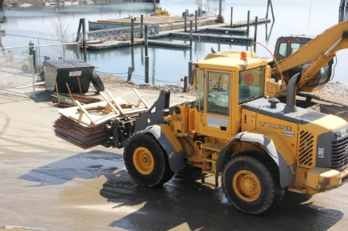
Who will benefit from this?
Is this a target area benefit?
At least 51% of the beneficiaries in the area must be LMI according to a survey of the users
Notes:
Target area benefits are typically for water and sewer projects where you are targeting certain streets. You’d survey the users on the defined streets to make assurances that 51% or more of the users are LMI. If your project entails the replacement of a pumping station, for example, you’d need to survey all the users of the system because the pump involves all the users. In some instances you could do a census overlay to indicate that the area falls within a census tract that is 51% or more LMI – Eastport is essentially an island….it’s one census tract….and that census tract indicates that the population is 51% or more LMI – therefore, no survey was necessary.

Slide 12

FOR PUBLIC INTRASTRUCTURE YOU WILL NEED AN INCOME SURVEY! EITHER OF THE USERS OF THE SYSTEM OR THE USERS IN THE LOCATION OF PIPE REPLACMENTS.
This Photo by Unknown Author is licensed under CC BY

Slide 13
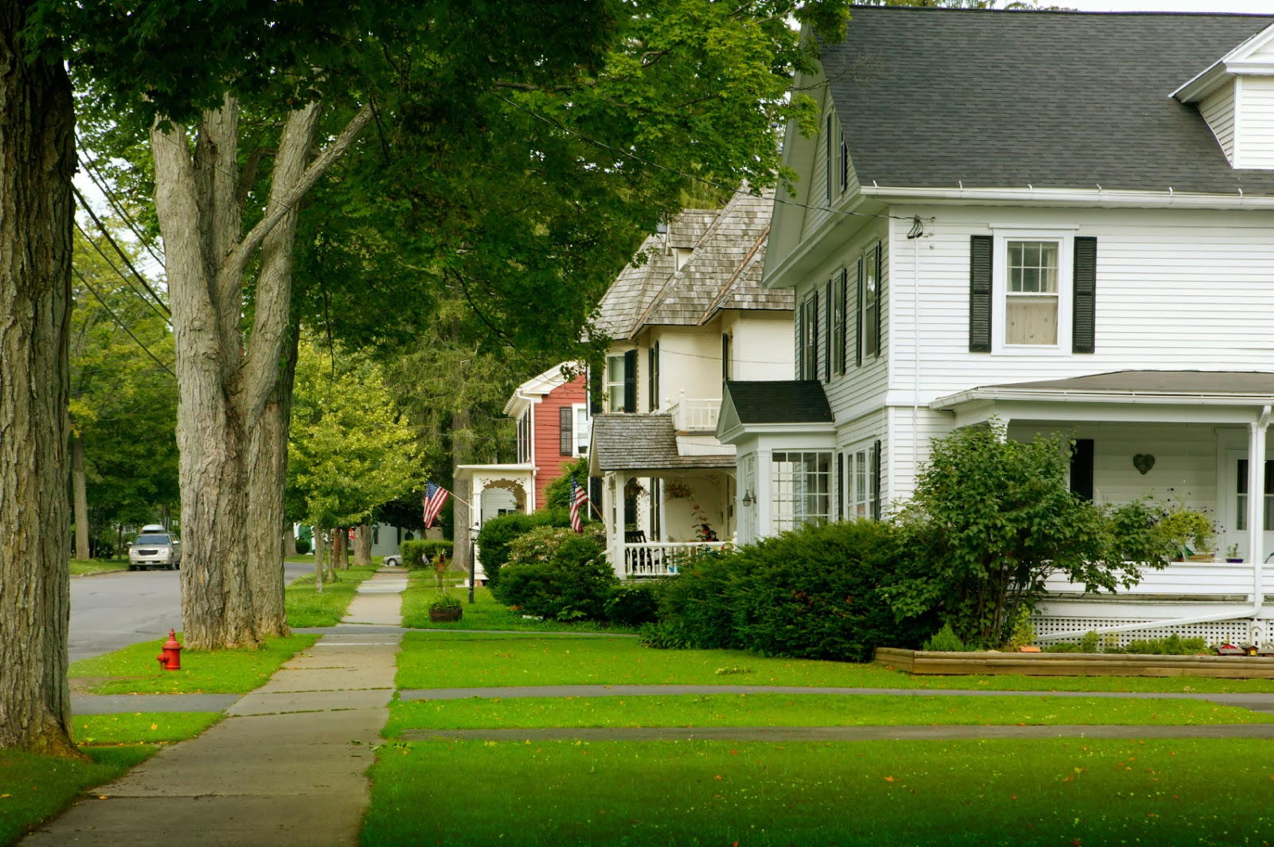
In order to be eligible 51% of the beneficiaries must be low to moderate income. This applies to Public Service Projects as well.
This Photo by Unknown Author is licensed under CC BY-NC-ND

Slide 14
Letter of Intent:
Name of Applicant (UGLG)
Grant specific information
  Name of A/E firm
  Name of Utility
Project Description – Problem, Solution, Funding need, Meeting benefit
Cost Estimates & Funding Sources/Commitment
National Objective Requirements
Grant specific attachments
Applicant Certifications
Notes:
The applicant is almost always a unit of general local government, unless you’re an unorganized territory, in which case the County could apply on your behalf.
Depending on the particular grant, we will request specific information to help us determine the readiness of your project. For example: if you haven’t gotten an architect or engineer on board for your construction process – who did the design and how did you come up with cost estimates? If you’re doing workforce training….and you haven’t identified an training program, you’re probably not quite ready to make application.
If you’ve followed all the steps we talked about, you should be able to accurately describe your project, solution, funding need and how you’ll meet benefit.
Cost estimates are just that…..cost estimates. For construction projects do not call local contractors and ask them for a bid. If you’ve got an architect or engineer on board, they should be able to develop reasonable cost estimates.
Know who your funding sources are or will be for the project. Be able to indicate that funds will be available at the time you make application. If you’re going to commit local funds, make sure you plan to hold your town meeting prior to application to vote to approve the funds. A letter from the Town stating that if you are awarded CDBG you will then hold a special meeting to vote on allocating funds is not a commitment of funds.
We’ll need to know in advance as to how you intend to meet benefit. Have you done a survey? Will you be collecting data (as in Workforce Development) as the project moves forward? How will you collect the data? Will HR collect the data for new hires?

Slide 15
Letters of Intent….
Contact us to review your project.
DPM name and date of Consultation is required on the LOI form.
We’ll help determine the merit of your project and project readiness.
We’ll make recommendations for other funding sources.
Make sure your project will meet a National Objective.
Notes:
DPM name and date of Consultation (required):

Slide 16
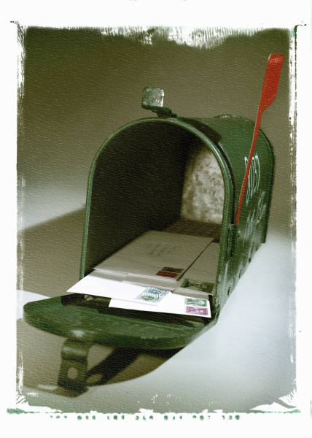
Letter of Intent Tips:
Be aware of submission deadline(s)
Submit as soon as possible
Must be emailed (with required attachments) to: ocd.loi@maine.gov
Notes:
Early submission is encouraged. Our turnaround can be much quicker if we’re not going through all LOI’s at the same time.
Overnight mail and next day mail aren’t a guarantee.
Snowstorms and early release can delay the delivery of your LOI.
Make sure all attachments accompany the LOI. You’ll get an automatic response indicating the receipt of your documents.

Slide 17

LOI to Application:
This Photo by Unknown Author is licensed nder CC BY-NC
Within 10 days of receipt of the LOI notification will be sent to the applicant (Town/City) via email and/or snail mail advising them as to whether the LOI has been approved or not, and if approved when to submit a full application.
Notes:
Make sure someone at the Town Office opens the mail….we’ve had instances where the First Selectman went on vacation and the Town didn’t have ample time to prepare an application once the mail was finally opened.

Slide 18
The Application has Three key pieces:
Impact
Strategy
Citizen Participation

Slide 19
Impact:
What is the problem?
How was it identified?
Why is it necessary to “fix it”?
Is it a priority?
How does it affect LMI persons?
How many LMI does it affect?
Why are CDBG funds necessary?

Slide 20
Development Strategy:
What are the specific improvements to be made?
How and when will CDBG funds be expended?
What are the positive results/financial benefits to LMI users?
What is the local experience with CDBG administration?
Budget review – all funding to be included

Slide 21
Citizen Participation:
How citizens were involved in identification and solution process.
Effective use of media to further awareness
Relevance of meetings
Involvement of potential beneficiaries and public hearing as it relates to the application and citizen participation
How other local resources (cash and in-kind) relate to the project.
THIS IS 20 VERY IMPORTANT POINTS!
Notes:
This is the area where most applications fall short – you’ve got an opportunity for at least 20 points in this section. One of the most critical parts of this is your required Public Hearing. Be mindful when scheduling your Public Hearing – if you schedule it too close to the application deadline and there’s a snowstorm where you need to postpone the meeting – you might not be able to hold it in time to submit an application. If you hold the Public Hearing in the afternoon, are you really giving your community an opportunity to participate and comment on the project? We provide you with the required language for posting your Public Hearing Notice….if you fail to use this language you will forfeit 5 points from this scoring section.

Slide 22
Our Process….
You can submit your Letter of Intent via email to ocd.loi@maine.gov at any time prior to the due date
You’ll receive an email confirmation of the receipt of your information.
Please put the grant category in the subject line.
Make sure all attachments accompany the LOI.
APPLICATIONS WILL ALSO BE SUBMITTED ELECTRONICALLY

Slide 23

Contact the Office of Community Development:
Terry Ann Holden- Office 207-624-9814
Cell-207-557-0964
https://www.maine.gov/decd/community-development
Office of Community
Development 207-624-7484
This Photo by Unknown Author is licensed under CC BY-NC

