Slide 1
Fundamentals of Grants Development

Slide 2
How to Begin
Developing the idea – what is my project?
What are the funding needs?

Slide 3
The Perfect Match
How do I find the right funding match?

Slide 4
The Perfect Match
Federal grants
State grants
Foundations

Slide 5
The Perfect Match
Search Engines/Tools
Grant Searches
Grants.gov (free, phone app)
U.S. Government Grant Search (free, phone app)
Fundsnet services.com (free)
Maine.gov
Congressional legislator web sites

Slide 6
The Perfect Match
Search Engines/Tools
Grant Searches
Grantwatch.com (membership based)
GrantStation.com (membership based)
The Grantsmanship Center (membership based)
Private Foundations – mainephilanthropy.org, google.com

Slide 7
Am I Eligible?
Fitting into funding priorities
Pitching your project

Slide 8
Planning Your Application
Know the funding entity - RFP/RFA/NOFO
Grant format
Table of contents/writing assignments
Create a template
Forms - SF-424 forms family and other federal reporting forms; foundation forms

Slide 9
Stating Your Case
Write a powerful statement of need
Fill an unmet need
Introduce the clients
Make your project meaningfully unique

Slide 10
Stating Your Case
Data Resources
U.S. Census American Factfinder
StatsAmerica
Robert Wood Johnson Foundation County Health Rankings
State of Maine Agencies
https://www.maine.gov/labor/cwri/county-economic-profiles/countyProfiles.html

Slide 11
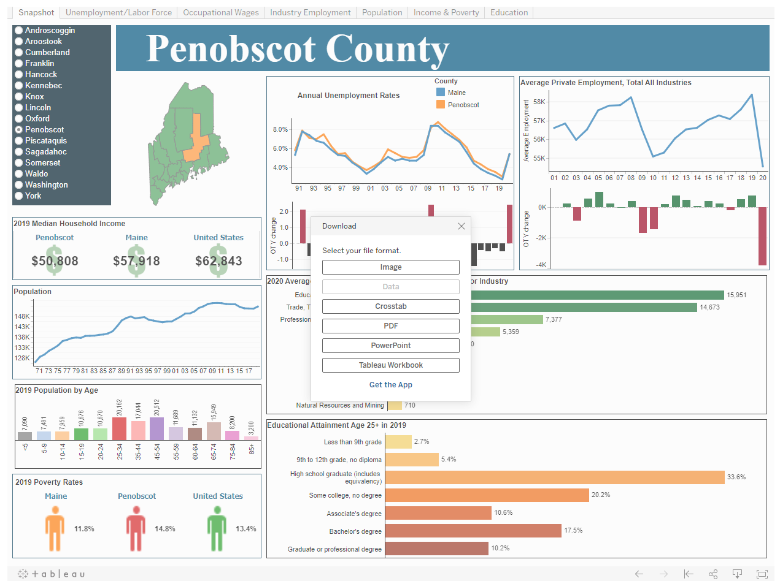

Slide 12
Stating Your Case
Team expertise and experience
Past accomplishments

Slide 13
Stating Your Case
Target population
Project description
Delivery of services
Marketing/outreach
Evaluation & Outcomes

Slide 14
Standing Apart From the Crowd
Why is funding your grant the best solution?

Slide 15
Budget
Defining the project or program costs
Preparing a budget narrative
Identifying leverage

Slide 16
Timeline
Articulate the implementation of project
Delivering the deliverables
Accomplish the goals and objectives
Evaluation points-in-time

Slide 17
Grant Attachments
Financial statements
Letters of support
Job descriptions
Resumes
Graphics (maps)
Data
Mandatory forms

Slide 18
A Little About Logic Models
(logical frameworks)
Matrix used to describe project development & evaluation
Categories
Inputs
Activities
Outputs
Outcomes
Impact

Slide 19
Find the Grant Package
Locate the funding application guidelines and forms

Slide 20
Applying For Federal Grants
IRS Tax ID number (EIN)
DUNS number
UEI Number
Register with www.grants.gov

Slide 21
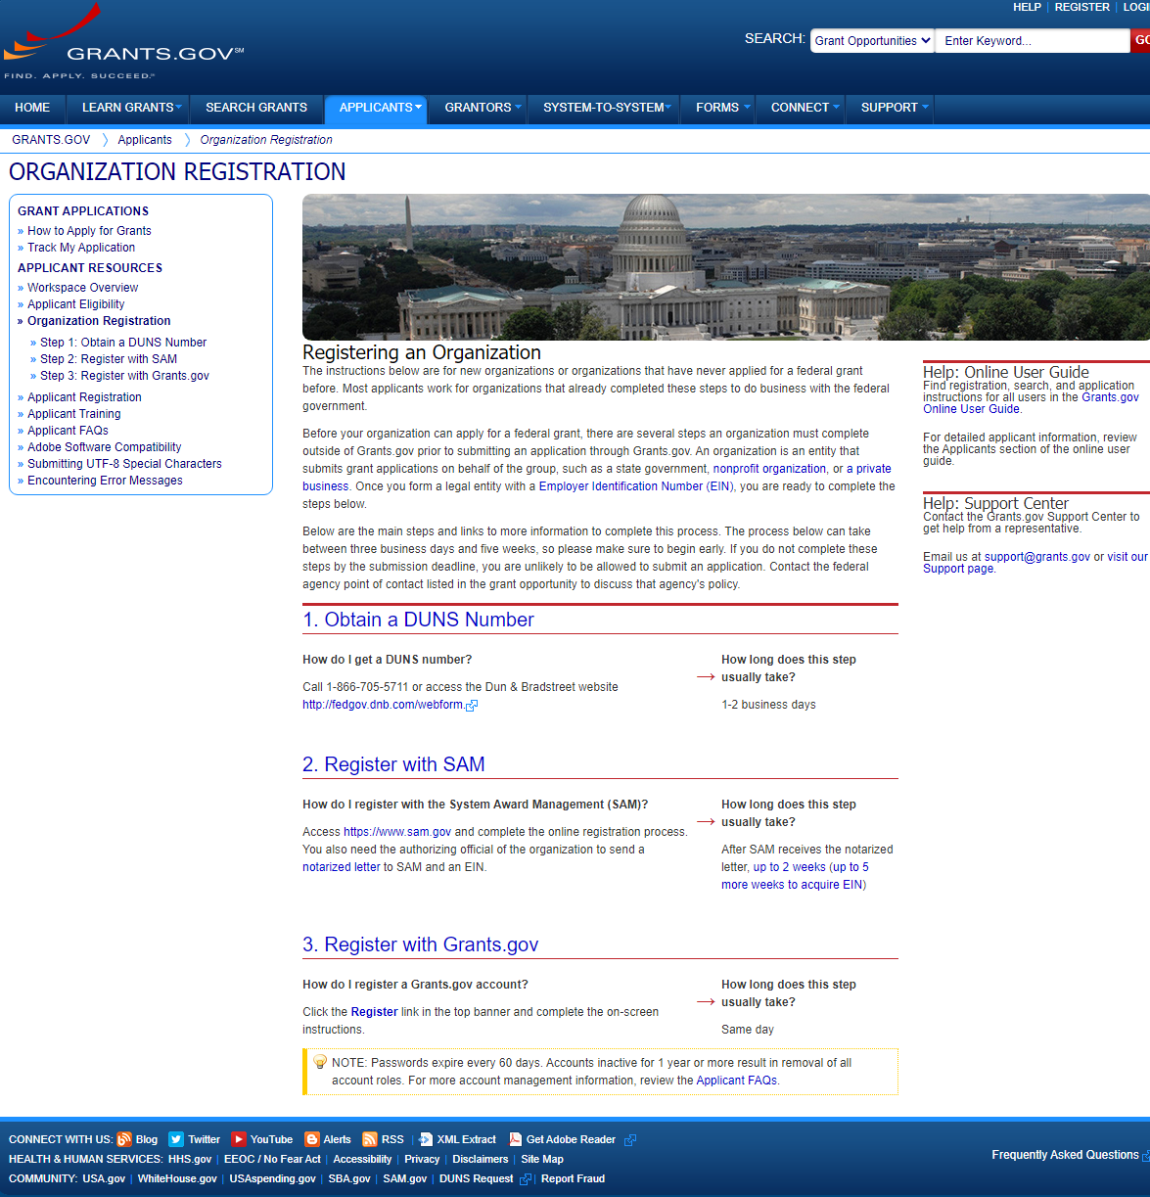

Slide 22
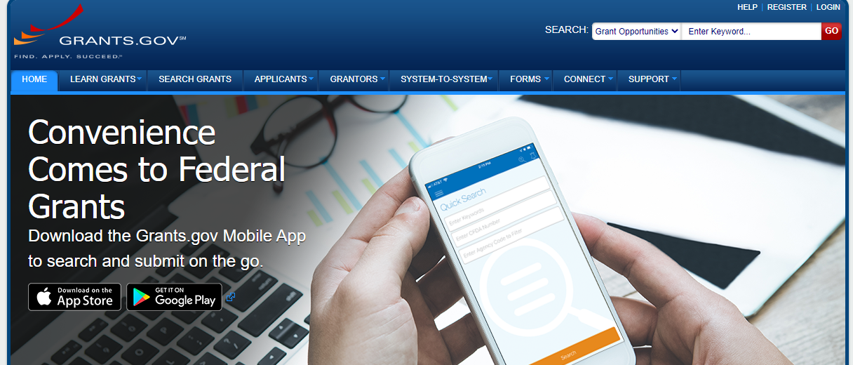

Slide 23
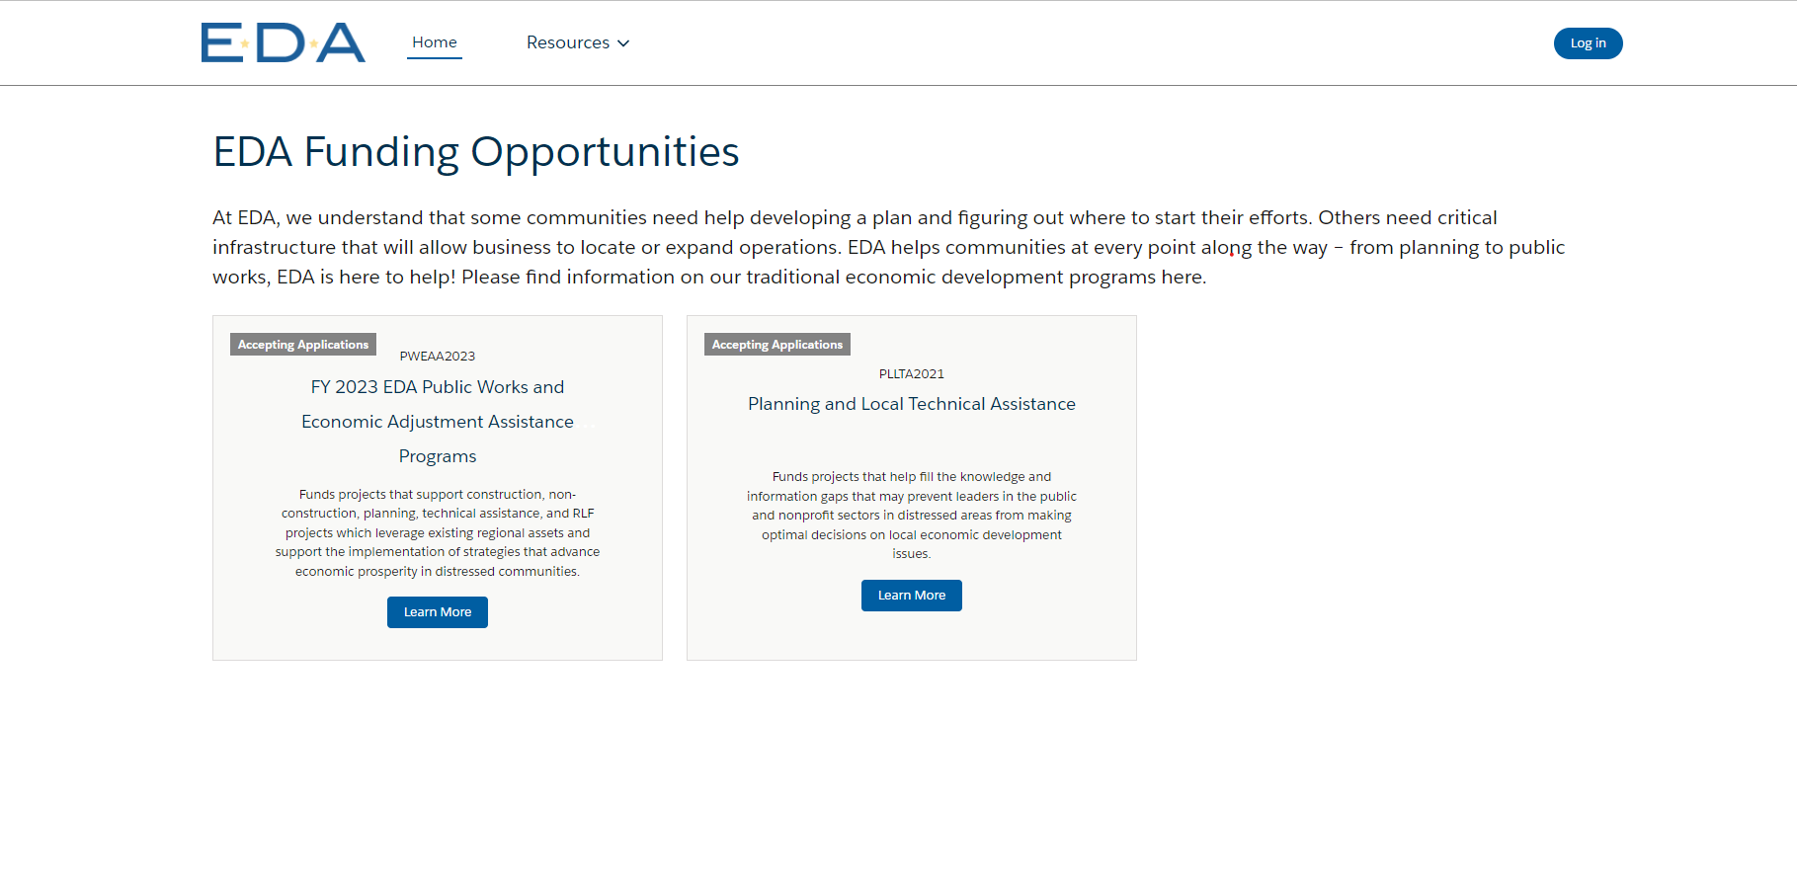

Slide 24
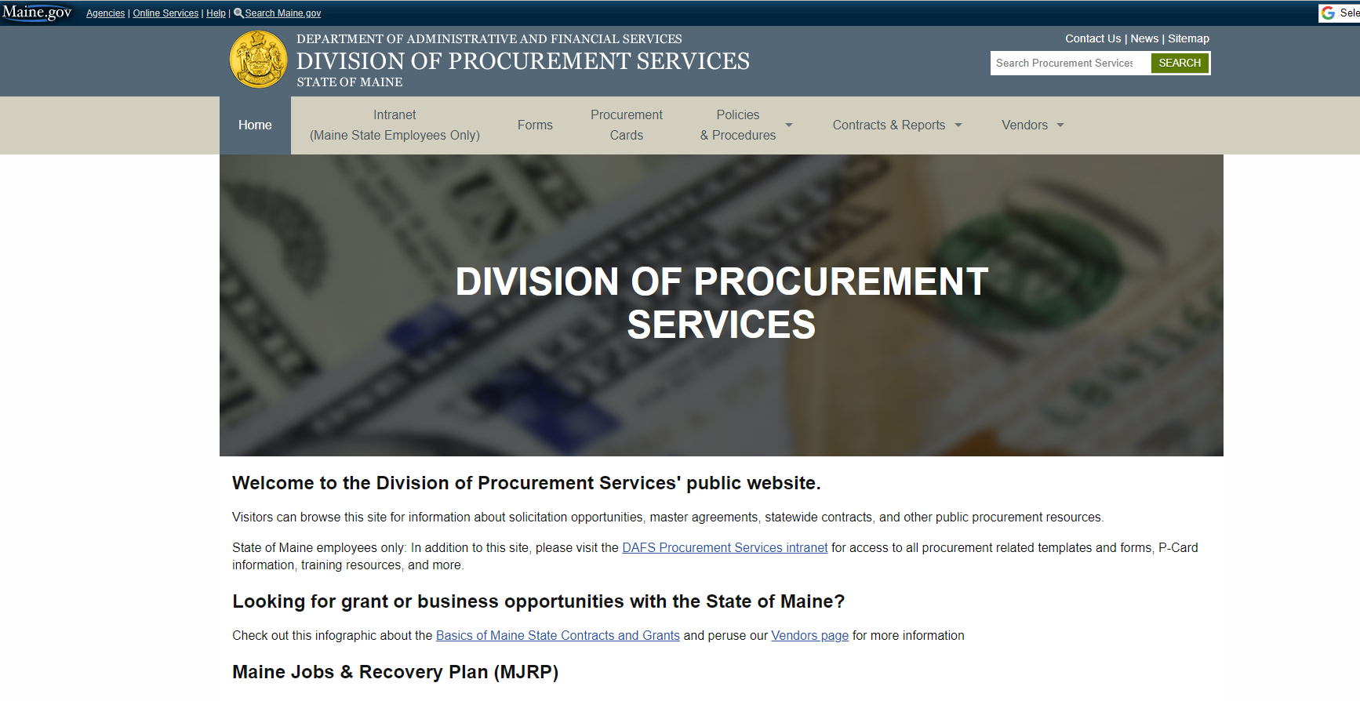
Finding Grant Opportunities from the State of Maine – Division of Procurement Services

Slide 25
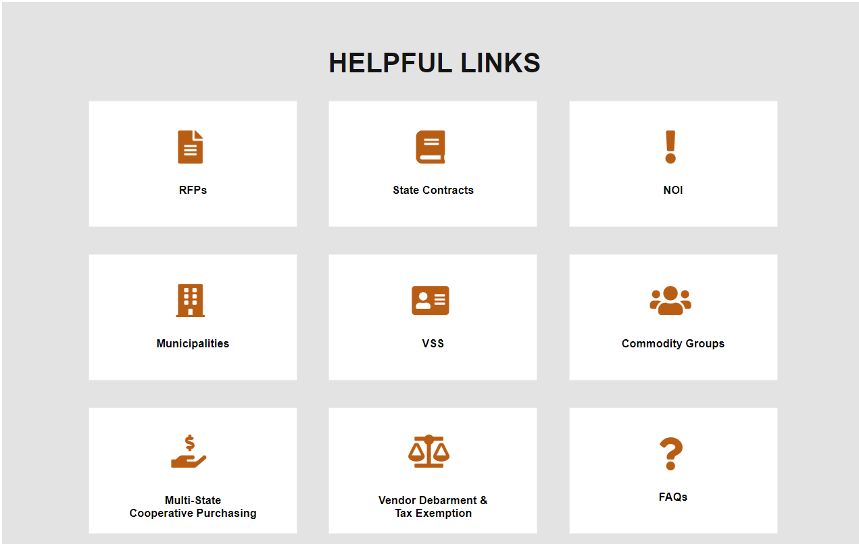
Maine Division of Procurement Services

Slide 26
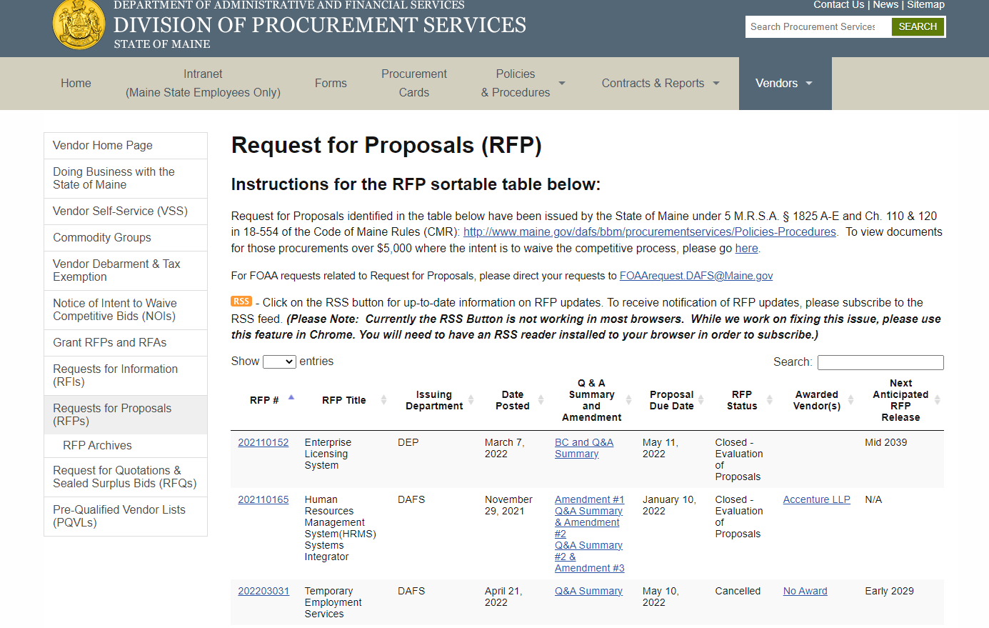
https://www.maine.gov/dafs/bbm/procurementservices/vendors/rfps

