Slide 1

U.S. Department of Commerce
Economic Development Administration (EDA) https://www.eda.gov
EMDC Grants Conference
May 23, 2023

Slide 2
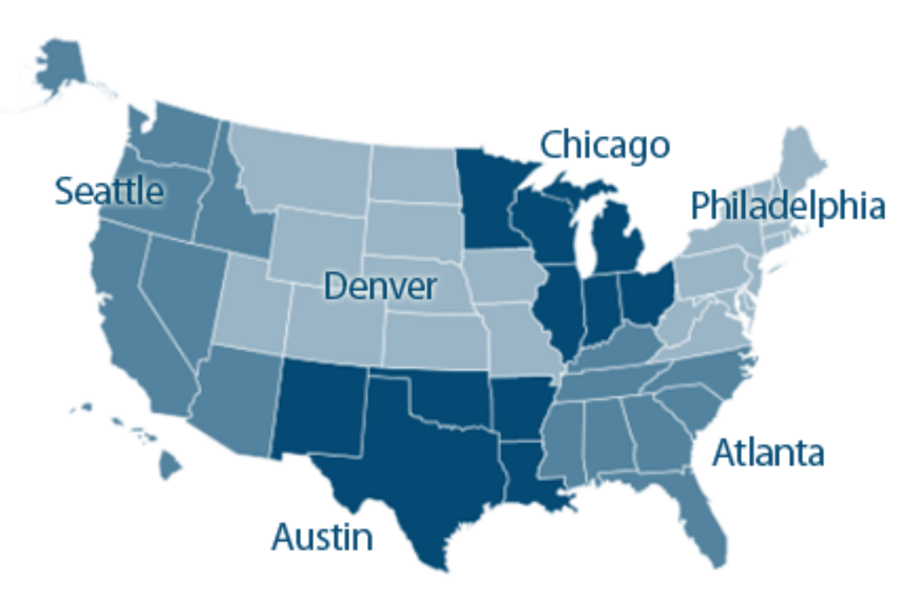
EDA Regions
Philadelphia
CT, DE, DC, ME, MD, MA, NH, NJ, NY, PA, RI, VT, VA, WV, PR, VI

Slide 3
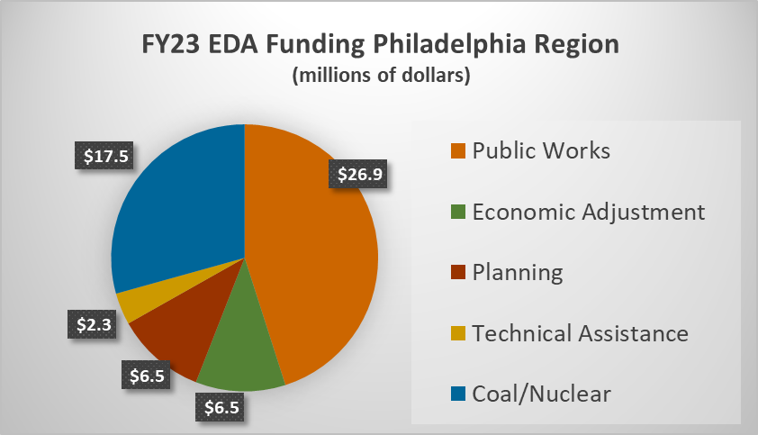
Regional Funding
Philadelphia Region
FY23 – $59.7m to be split among 16 states and territories
1/3 urban -- 2/3 rural
CARES/ARPA funds are exhausted
FY 23 Disaster Supplemental for 2021-2022 ($103m) events is in addition to this.*
FY 22 Biomass - $3m

Slide 4
EDA Regional Office Programs (currently accepting applications)
 | Public Works | Construction projects such as roads/utilities, multi-tenant manufacturing buildings, industrial parks, brownfield redevelopment, port and harbor infrastructure, broadband, equipment. Typically includes design and engineering. NOTE: Opportunity Zones no longer included in Special Need. | FY 23 PWEAA NOFO (Notice of Funding Opportunity)
 | Economic Adjustment | Non-construction projects such as workforce training and revolving loan funds. Construction projects for special needs (disaster, factory closure, etc.). Set aside for Coal, Nuclear, Biomass communities.
 | Planning Partnership | Annual assistance for designated Economic Development Districts (EDD) and tribal government for development of the Comprehensive Economic Development Strategy (CEDS). | FY 21-23 Planning and LTA NOFO
 | Local Technical Assistance | Feasibility and market studies. Utility demand analyses. Incubator studies.
 | Disaster (Supplemental) | Long-term economic recovery strategies through a variety of non-construction and construction projects, as appropriate, to address economic challenges in areas where a Presidential declaration of a major disaster was issued. | FY 23 Disaster Supp. NOFO
Notice of Funding Opportunities at https://www.eda.gov/funding
More programs to come!

Slide 5
EDA Headquarters Programs (currently or soon accepting applications)
 | Tech Hubs Phase 1 (Deadline: August 15) | (From CHIPS Act) EDA will designate at least 20 Tech Hubs across the country and award $15 million in strategy grants to accelerate the development of future Tech Hubs designed to drive regional capacity to manufacture, commercialize, and deploy critical national security technologies. Applicants must be part of a coalition. | FY 23 Tech Hubs Phase 1 NOFO
 | STEM | Innovative science, technology, engineering, and mathematics (STEM) work-based learning models (such as Registered Apprenticeships) that complement their respective region’s innovation economy. | FY 23 STEM Challenge NOFO
 | Economic Recovery Corps (Deadline: June 30) | The International Economic Development Council (IEDC) and its partners are seeking to place up to 65 Economic Recovery Corps (ERC) Fellows for 30-month placements to activate economic development projects or plans that generate new practices and paradigms for equitable and inclusive change. | IEDC call for host organizations
 | Recompete | Helps communities with high prime-age (25-54) employment gaps through place-based, targeted strategy and implementation investments that tackle the unique challenges these communities face. | NOFO forthcoming
Notice of Funding Opportunities at https://www.eda.gov/funding
More programs to come!

Slide 6

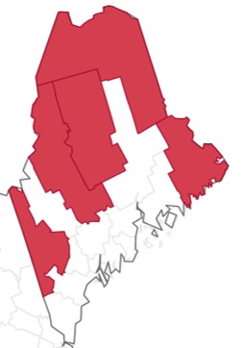
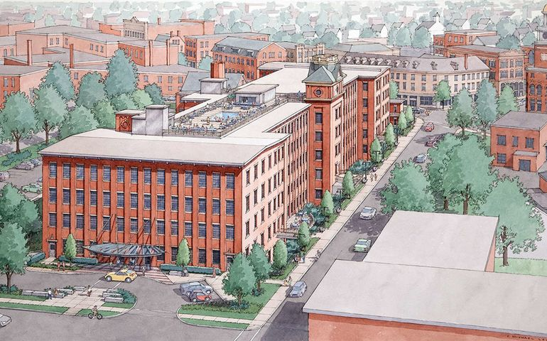
Region
Applicant
Project
Program Eligibility

Slide 7
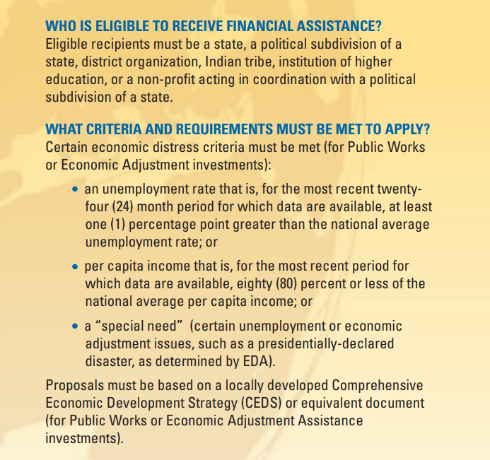
Applicant Eligibility
Region
Applicant
Project
Ineligible: EDA does not award grants to private companies or individuals.

Slide 8
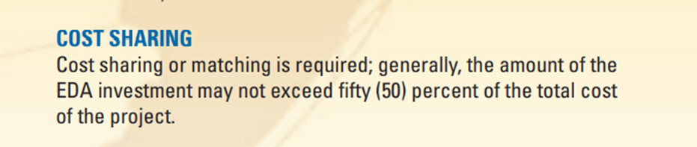
Regional Eligibility
Region
Applicant
Project
Regions are
self-defined.
(County, municipality, census tract,
labor market area, river valley, etc.)

Slide 9
Project Eligibility
Non-Construction: The investment’s scope of work must primarily benefit an eligible region and stakeholders from that eligible area must be directly engaged. Planning, Technical Assistance, and Revolving Loan Funds are all Non-Construction.
Construction projects: The project may include design/engineering and must be located in an eligible region.
  Region that meets EDA’s economic distress criteria.
  Economic Development District (EDD) that is located in a region that does not meet EDA’s economic distress criteria, but that EDA determines the proposed project will be of substantial direct benefit to a geographic area within the EDD that meets EDA’s economic distress criteria.
  Geographic area of poverty or high unemployment that meets EDA’s economic distress criteria, but which is located in a region that overall does not meet EDA’s distress criteria.
Region
Applicant
Project
Ineligible: Housing, casinos, golf courses and retail (some exceptions). EDA does not duplicate investments of other agencies or support relocation of jobs from one region to another.

Slide 10
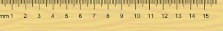
Investment Priorities and Metrics
All projects must advance one or more of EDA’s Investment Priorities:
  Equity
  Recovery and resilience
  Workforce development
  Manufacturing
  Technology based economic development
  Environmentally sustainable development
  Exports and foreign direct investment (FDI)
Economic Impact Metrics:
  Created jobs
  Retained jobs
  Private investment

Slide 11
Application and Award Process
Project Development
Application
Review / Due Diligence
IRC / Decision
Award
Post Award
Read the NOFO.
Read it again.
Work closely with your EDD and your Econ Dev. Rep. (EDR) on eligibility, project scope and budget!
Accepted on a rolling basis. No deadlines. Projects are awarded as they come in – not at the end of the year. More info on next slide!
Undergoes rigorous review by EDR and subject matter experts.
Curing of minor deficiencies.
Noncompetitive projects will get a denial letter.
The EDR presents the application to the Investment Review Committee (IRC). Competes against other projects in the state and in the region.
The IRC will issue either a denial or a non-binding commitment letter, typically with a request for additional information. If met, an award will be made.
Construction/RLF projects handed off to Engineering/ Finance. All other projects managed by EDR. Semi-annual financial and progress reports and reimbursement requests.

Slide 12
How to Apply for EDA Funding
Applications no longer accepted on grants.gov.
However, some of the forms required in the application are downloadable at grants.gov.
New grant management system and application platform “EDGE.”
https://sfgrants.eda.gov
Salesforce platform for applications and project management.
As of 4/6/23
Step 1. Register for an account.
Authorized Representative MUST have an account.
Step 2. Set up application team.
Step 3. Apply. Populate forms and upload attachments.
Step 4. Save workspace. Do NOT hit submit until I review it!
Step 5. SUBMIT starts the formal review process.
Grants Online (planning) and OPCS (most other projects) awards will be migrated to EDGE by 2024.

Slide 13
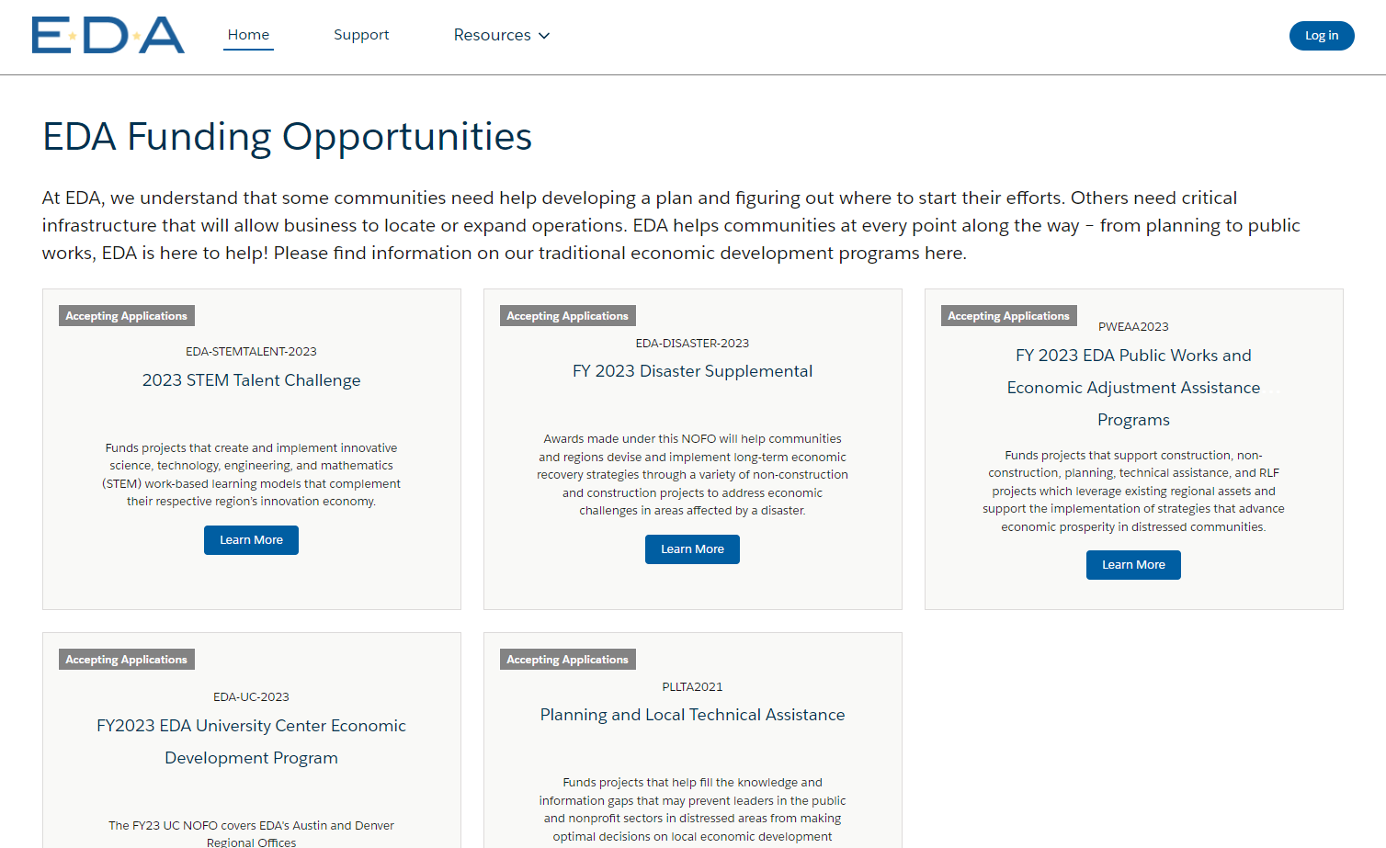
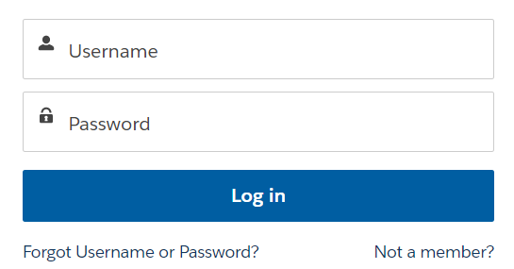
EDGE Portal
Click “Not a member?” to create a new account

Slide 14
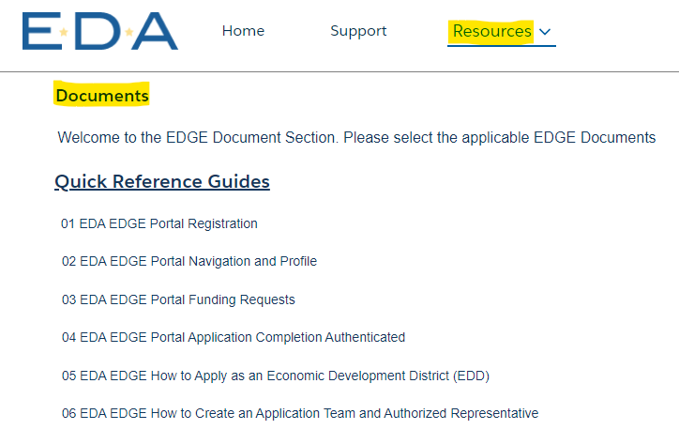
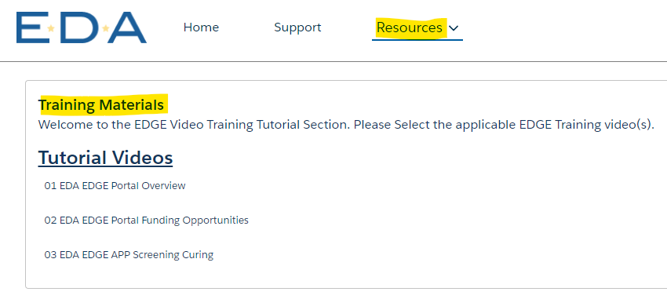
EDGE Portal
If you are unable to register or log in, please contact the EDGE Help Desk for support at grantHDsupport@eda.gov

Slide 15
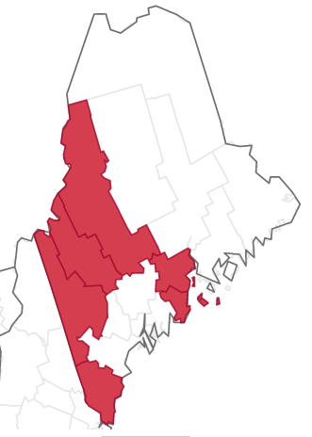
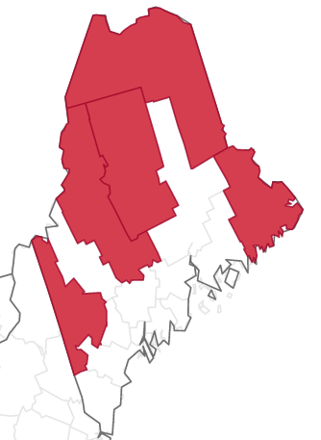
Eligible Counties
Disaster Declarations 2021/2022
Franklin
Knox
Oxford
Somerset
Waldo
York
Per Capita Income
Washington
Somerset
Piscataquis
Oxford
Aroostook
NOTE: individual census tracts and other geographies (i.e. a river valley or a labor market) could also be eligible using PCI or unemployment rate.
PCI and unemployment data change over time. Visit https://www.statsamerica.org/distress

Slide 16
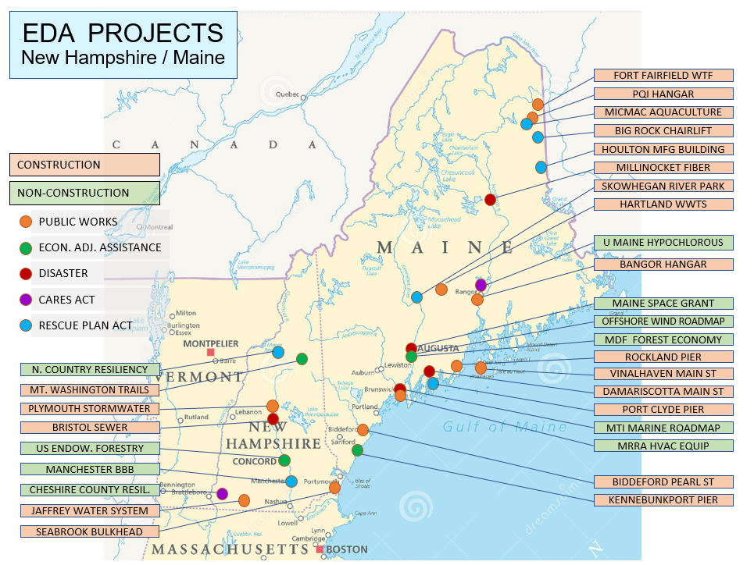

Slide 17
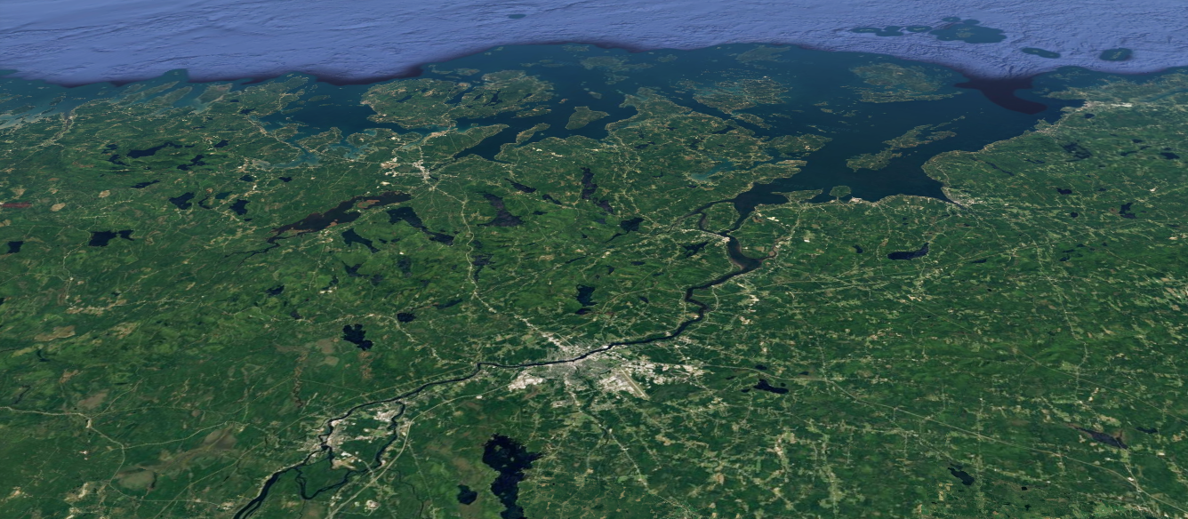

Katherine Trapani
Program / Management Analyst ktrapani@eda.gov
215-514-6572
Questions?
Thank you!
https://sfgrants.eda.gov

